Slide 1
Chapter 1
What is Cognitive Psychology?
Notes:
Hi Everyone! In this video, I’ll be covering Chapter 1 of your textbook. The goal of this video is to give you a brief overview of Cognitive psych as a field. By the end of this video, you should have an understanding of what cognitive psych seeks to study and a historical overview of the discipline. In addition to watching this video, be sure to read chapter 1 of the text!
Anyways, let’s get started!

Slide 2
Cognition is Complex!
Cognition involves:
  Perception
  Paying attention
  Remembering
  Distinguishing items in a category
  Visualizing
  Understanding and production of language
  Problem solving
  Reasoning and decision making
Notes:
Cognition is broad!
All centers around how we process information, whether its visual, audio, etc.

Slide 3
Cognitive Psychology Defined
Cognitive Psychology
  The branch of psychology concerned with the scientific study of the mind
  Cognition refers to mental processes, such as perception, attention, and memory, that the mind creates

Slide 4
Studying the Mind
To understand complex cognitive behaviors:
  Measure observable behavior
  Make inferences about underlying cognitive activity
  Consider what this behavior says about how the mind works
Notes:
How do we go about this? Measure observable behavior! Make inferences!

Slide 5
Early Work in Cognitive Psychology
Donders (1868): How long does it take for someone to make a decision?
  Reaction time (RT) experiment: Measures interval between stimulus presentation and person’s response to stimulus
  Simple RT task: participant pushes a button quickly after a light appears
  Choice RT task: participant pushes one button if light is on right side, another if light is on left side
Notes:
Cognitive psych is relatively modern (1950’s) but its history goes back to the 1860’s. F. C. Donders might be considered the first cognitive psychologist. He had simple question: How long does it take someone to make a decision? Or to put another way, how can we quantify human thought?
He did this by comparing two tasks – Simple RT and Choice RT

Slide 6
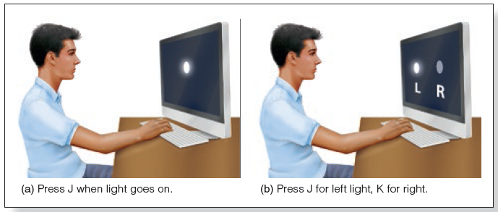
Donders’ Study of Reaction Time
No decision
Decision: L or R?
Notes:
Example: On the left, the participant presses the key when they see the light – this is a classic reaction time study. On the right, same thing, but now they have to decide which side of the screen the light is on. Now donders wasn’t using computers (1860’s) but he was comparing simple vs choice tasks

Slide 7
Donders’ Study of Reaction Time (3 of 3)
Choice RT − Simple RT = time to make a decision
  Choice RT = 1/10th sec longer than Simple RT
  1/10th second to make decision
  Important! Mental responses cannot be measured directly but can be inferred from the participant’s behavior
Notes:
By doing this, the time it takes to make a decision can be found by subtracting the simple rection time from the choice reaction time. Presumably, the task takes longer when there is a choice, and this added time reflects the additional cognitive processes required to make a decision
Keep in mind that this isn’t directly measuring mental processes (i.e., decision making). Instead, Donders was inferring it based on the participant’s behavior

Slide 8
Wundt: Structuralism and Sensations
Wundt (1879) established first scientific psychology lab at University of Leipzig, Germany
Developed approach called structuralism:
  overall experience is determined by combining basic elements of experience called sensations
Used method of analytic introspection:
  participants trained to describe experiences and thought processes in response to stimuli
Notes:
Approaches to studying the mind underwent a vast shift in the decades following Donder’s work. Less emphasis was placed on inferring mental processes from observed behavior, and more emphasis was placed on understanding the mind through introspection (literally “thinking” about thinking – super meta!)
Wilhelm Wundt pioneered this approach in the 1870s-80’s. Termed structuralism, it sought to boil consciousness down to its constituent parts (i.e., sensations). Sensations could then be studied through introspection

Slide 9
Ebbinghaus: Memory and Forgetting
Ebbinghaus (1885/1913) read list of nonsense syllables aloud to determine number of repetitions necessary to repeat list without errors
After taking a break, he relearned the list
  Short-break intervals = fewer repetitions necessary to relearn list
  Learned many different lists at many different retention intervals
Notes:
Introspection quickly took off. In a prominent example, Hermann Ebbinghaus used introspection to study memory.

Slide 10
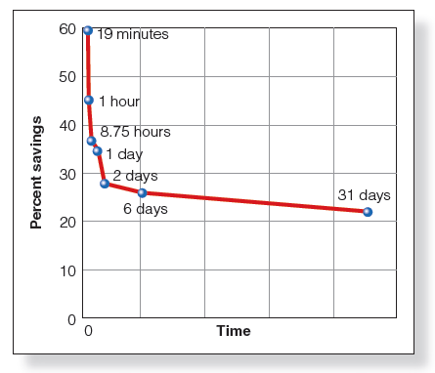
Ebbinghaus: Memory and Forgetting (2 of 2)
  Savings = (Original time to learn list) − (Time to relearn list after delay)
  Savings curve shows savings as a function of retention interval
  Lots of progress at first!
    Hit a wall after about two days…
Notes:
Note that after a two days savings really begins to drop off. Most learning seems to occur within the first few days.
Question though is how well does this effect generalize? Ebbinghaus performed the experiment on himself. Essentially he was the researcher AND the participant. One big problem w/ introspection is that its impossible to be impartial/unbiased when you are studying yourself.

Slide 11
Watson and Behaviorism
John B. Watson noted two problems with analytic introspection method:
  Extremely variable results per person
  Results difficult to verify due to focus on invisible inner mental processes
Proposed a new approach called behaviorism
  Eliminate the mind as a topic of study
  Instead, study directly observable behavior
Notes:
John B. Watson took this idea a step further, and decided that it was impossible to scientifically study the mind. So he decided that the mind didn’t matter and that observable behavior was the only thing worth studying. He termed this new approach Behaviorism, which became the dominant approach in psych throughout the early 1900’s

Slide 12
Watson’s “Little Albert” Experiment
Watson and Rayner (1920)
  9-month-old Albert became frightened by a rat after a loud noise was paired with every presentation of the rat
  Examined how pairing one stimulus with another affected behavior
  Demonstrated that behavior can be analyzed without any reference to the mind

Slide 13
Classical Conditioning
“Little Albert” experiment used classical conditioning methods
Pair a neutral event with an event that naturally produces some outcome
After many pairings, the “neutral” event now also produces the outcome
Notes:
Watson’s work was primarily based on classical conditioning

Slide 14
Skinner: Conditioning and Behaviorism
B. F. Skinner interested in determining the relationship between stimuli and response
Operant conditioning
  Shape behavior by rewards or punishments
  Rewarded behavior more likely to be repeated
  Punished behavior that less likely to be repeated
Skinner’ behaviorism approach was dominant from the 1940s through the 1960s
Notes:
Skinner then took this a step further by looking at how rewards/punishments affected behavior

Slide 15
The Reemergence of the Mind in Psychology
Tolman (1938) trained rats to find food in a four-armed maze
When a rat was placed in a different arm of the maze, it went to the specific arm where it previously found food
  Tolman believed the rat had created a cognitive map, a mental representation of the maze
  The map helped the rat navigate to a specific arm despite starting the maze from a different spot
  Rejected the behaviorist perspective for the rat’s actions
Notes:
However, other researchers weren’t so sure about this whole “the mind doesn’t matter” thing that the behaviorists had going on…..
Mental representation == mind! If there is a mind, well that means behaviorism isn’t perfect and might instead be missing something important

Slide 16
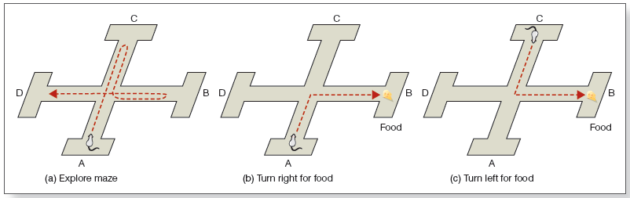
Tolman’s Maze and Cognitive Mapping
Notes:
Left panel, mouse explores and empty maze. Middle panel, mouse learns that if it turns right, it gets food. Right panel, mouse is placed on the opposite side. If its purely behaviorism, mouse knows that “turn right” == food. But Toman observed that the mouse immediately turned left (went towards B) where it remembered the food. Thus, he concluded that the mouse could remember the layout of the maze, not just “turn right for food”

Slide 17
The Decline of Behaviorism (1 of 2)
A controversy over language acquisition
Skinner (1957) – Verbal Behavior
  Argued children learn language through operant conditioning
    Children imitate speech they hear
    Correct speech is rewarded
Notes:
What brought the debate over the mind to a head though was language acquisition. Skinner was convinced that language as learned through operant conditioning – that children are rewarded for correct speech and punished for incorrect speech. Basically, everything is learned via imitation then reward/punishment

Slide 18
The Decline of Behaviorism (2 of 2)
Noam Chomsky (1959)
  Argued that children do not only learn language through imitation and reinforcement
    Children say things they have never heard and cannot be imitating
    Children say things that are incorrect and have not been rewarded for
  Language must be determined by inborn biological program
Notes:
But children say things all the time that they never heard. “My foots hurt” Adults would say “feet”. Chomsky argued that this meant language had to be inborn/innate

Slide 19
Cognitive Revolution!
Shift from behaviorist’s stimulus–response relationships to an approach that attempts to explain behavior in terms of the mind
Information-processing approach
  Way to study the mind based on insights associated with the digital computer
  States that operation of the mind occurs in stages
Notes:
This led to a shift towards a study of the mind, rather than just behavior.

Slide 20
Attention and Flow Diagrams
Cherry (1953)
  Present message A in left ear and message B in right ear
  Subjects could understand details of message A despite also hearing message B
Broadbent (1958) developed flow diagram to show what occurs as a person directs attention to one stimulus
  Unattended information does not pass through the filter

Slide 21
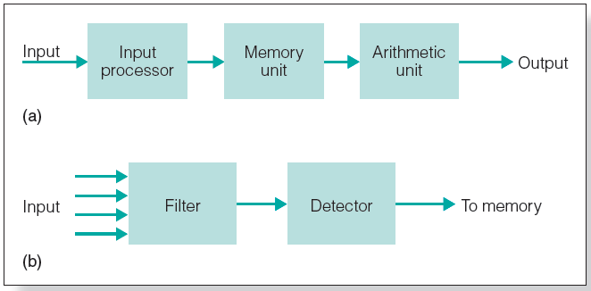
Flow Diagrams
Notes:
Flow diagrams allow for modeling complex cognitive processes. We’ll talk about these more in later chapters when we discuss memory and attention

Slide 22
Memory: A Higher Mental Process
Atkinson and Shiffrin (1968) developed a three-stage model of memory:
  sensory memory (less than 1 second)
  short term memory (a few seconds, limited capacity)
  long-term memory (long duration, high capacity)
Information we remember is brought from long-term memory into short-term memory
Notes:
Speaking of memory, it wasn’t until the cognitive revolution that researchers started attempting to model the processes underlying human memory. Many different types! Differentiated by how long information is stored in them

Slide 23
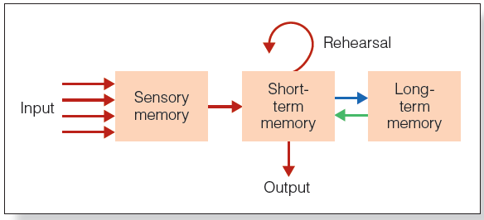
Atkinson and Shiffrin’s (1968) model of memory

Slide 24
Tulving’s Model of Memory
Tulving (1972, 1985) divided long-term memory into three components
Long-term memory
  Episodic
    Life events
  Semantic
    Facts
  Procedural
    Physical actions
Notes:
No longer just length. Also distinguished by content!
Anyways, that’s all for this video. In the next one, we’ll discuss perception and how quickly and easily process complex information from the environment

